Slide 1

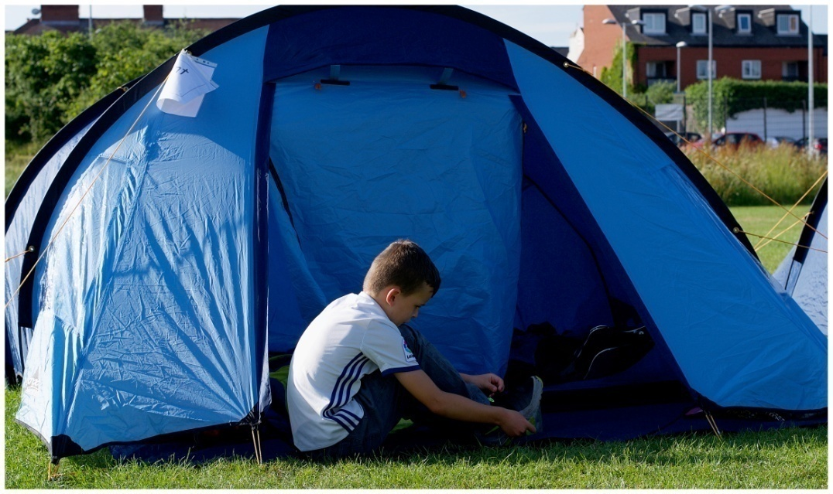
Round Hill Primary School
Year 2 Camp 2026

Slide 2
Aims of the Meeting
Why is there a Year 2 camp?
Safety
Staffing
Medication
Camp kit list
The schedule for the camp
Arrival information
Activities that the children will be involved in
Sleeping arrangements
The next day

Slide 3
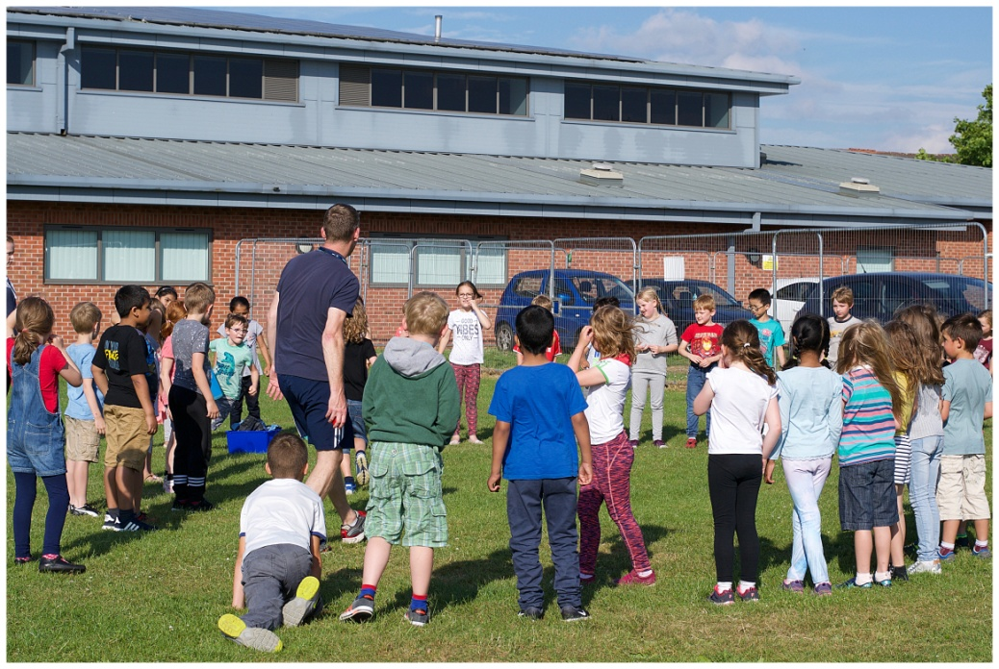
Camp Date-
Thursday 2nd July 2026

Slide 4

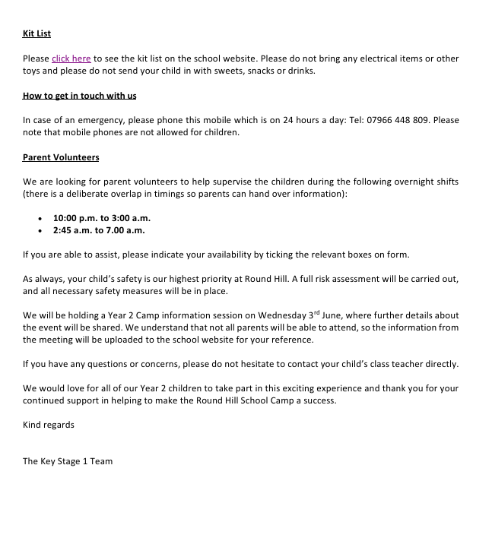
Year 2 Camp Letter and Consent Form

Slide 5
Why is there a Year 2 camp?
It’s fun!
Camp is a new, fun and exciting experience.
Social skills
Great opportunities to develop a wide range of social skills that strengthen established friendships and develop new ones. Activities planned involve co-operation and team work.
Independence
For some children, school camp may be their first time away from home where they have to remember to brush their teeth! Most children rise to this challenge and enjoy this new found independence.
Meet some of the Year 3 teachers
The children will be joined by some of the Year 3 teachers who will be leading and participating in some of the activities.

Slide 6
Safety
As always, your child’s safety remains of the upmost importance to Round Hill, therefore a full risk assessment has been carried out and approved by the local authority and all other necessary measures have been put in place.

Slide 7
Medication
If your child requires any medication during the camp, then please fill out the medical form on the camp letter.
If you would like to speak to your child’s class teacher about your child’s medication, then please arrange an appointment prior to the Year 2 camp.

Slide 8
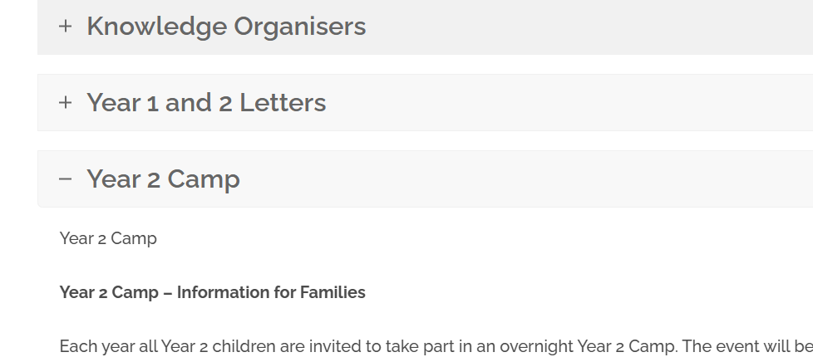
Year 2 Camp
Kit List
Each child will need:
Night clothes- A pair of pyjamas or something to wear to go to sleep in
Towel - The children will have a wash in school in the morning
Toiletries – toothbrush, comb etc.
Warm clothes for playing outside i.e. a jumper and tracksuit bottoms
A water proof coat just in case!
A warm sleeping bag
A roll mat
A pillow
Trainers for outdoor activities
Water bottle
Optional
A cuddly toy for bedtime
A book or magazine for bedtime reading.
A torch
Please do not bring any electrical or other toys.
Please do not send your child with any sweets, snacks or drinks.

Slide 9
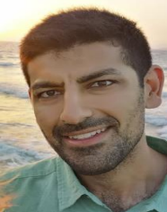
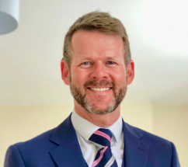

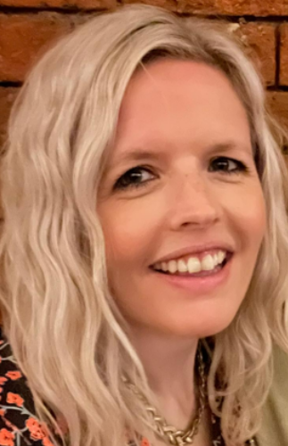

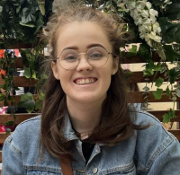
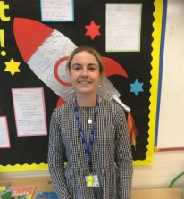
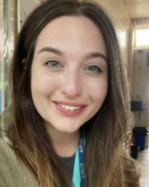
Staffing
We have lots of staff who help and stay over at the Year 2 Camp.
Evening and overnight staff:
Evening staff
Mr Khalique
(Foxes Class Teacher)
Mr Nash
(Head Teacher)
Mrs Dowsett
(KS1 Phase Leader/
Rabbits Class Teacher)
Mrs Johnson
(KS1 Phase Leader/
Rabbits Class Teacher)
Mrs Richards
(EYFS leader/Bluebells
Class Teacher)
Miss Swankie
(Badgers Class Teacher)
Mrs Purkis
(Otters Class Teacher)
Miss Barton
(Hedgehogs Class Teacher)

Slide 10
Routine for Evening
Register (see timings on the letter)
Settle into tents
Split into groups to complete fun activities
Read stories and sing songs (Mr Khalique!)
Get ready for bed
Read/chat in tents
Sleep (we hope!)

Slide 11
When to arrive at school
The children will leave school at the normal time of 3.30pm and have their dinner at home.
They will then return to school at their allotted time with their ‘kit’ ready to stay the night in the school.
Foxes (5.25pm-5.30pm)
Hedgehogs (5.30pm-5.35pm)
Rabbits (5.35pm-5.40pm)
Please bring your child directly to the registration table so that we know that they are on site. We will also be able to take any of the children’s medication from you.
Please assist us by keeping goodbyes to a minimum, so as not to prolong any upset. We will have all your contact details if there is a problem.

Slide 12
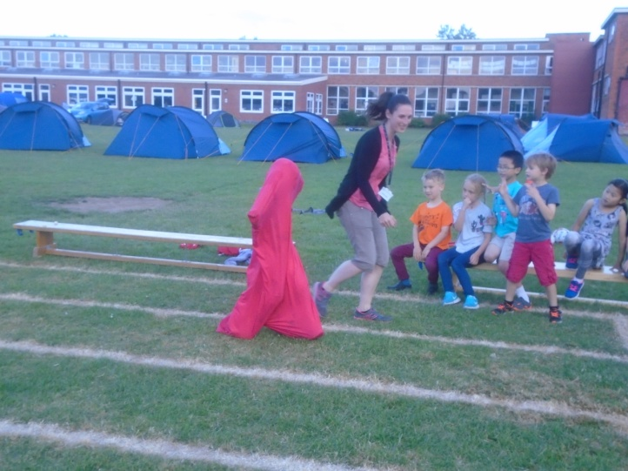
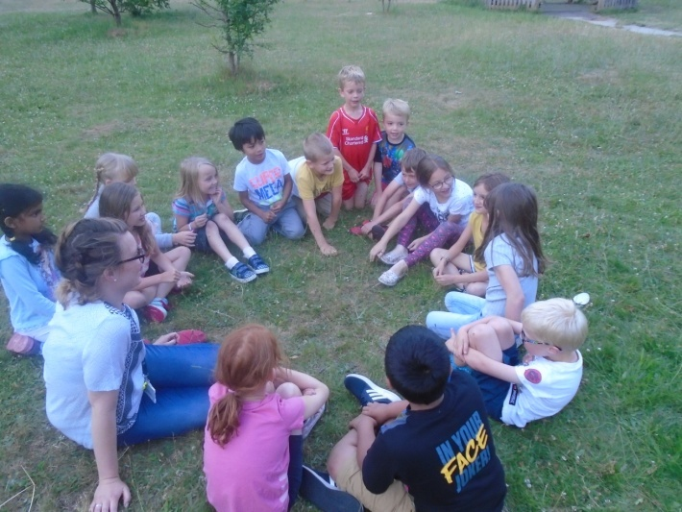
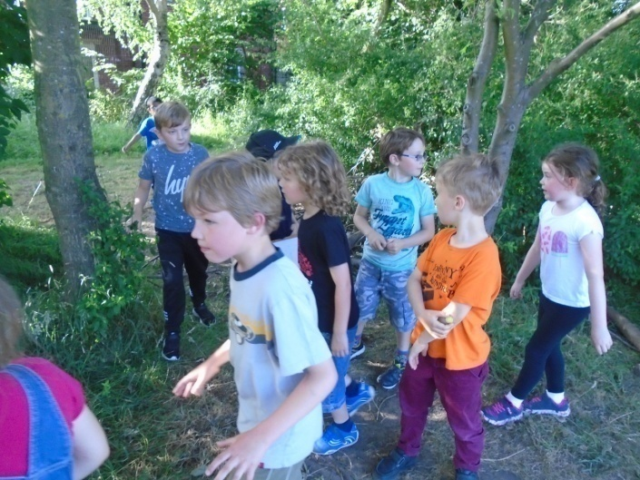
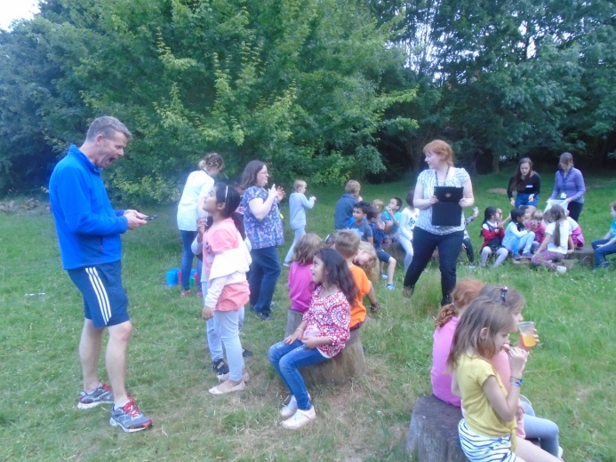
Activities
Obstacle Course
Parachute games
Orienteering
Scavenger hunt
Outdoor art/music
activities

Slide 13
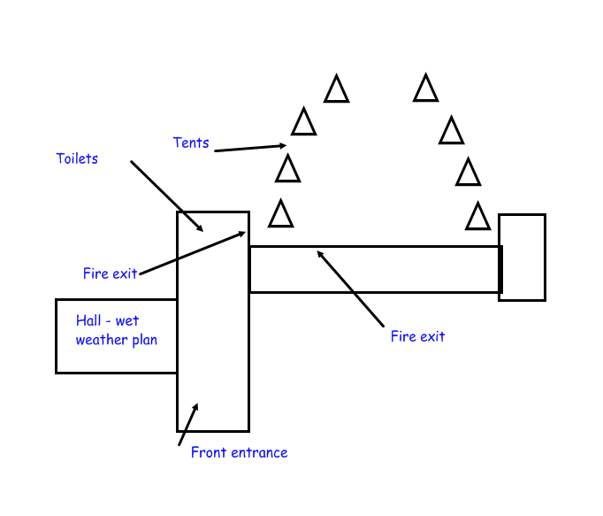
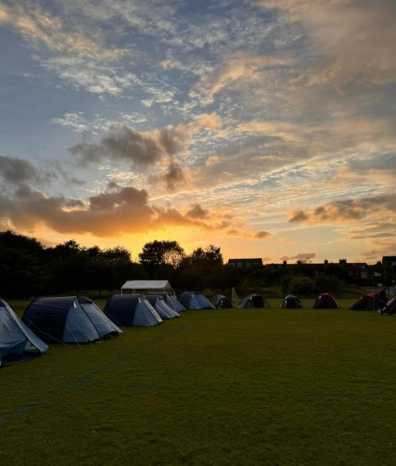
Sleeping Arrangements
Same gender tents.
Friendship groups (3 or 4 in a tent).
The children will try go to sleep between 8.00pm and 8.30pm.
Wet Weather Plan

Slide 14
Volunteers
Thank you to all parents who volunteered to support the Year 2 Camp. Your help is greatly appreciated. The school office has contacted the parents who have been selected to volunteer.
Parent volunteers will support the camp in two shifts:
• 10:00 pm – 3:00 am
• 2.45am – 7:00 am
Our parent volunteers provide valuable support overnight, helping to supervise and support the children, offering comfort and reassurance, and informing teachers if a child is unwell or needs assistance.

Slide 15
The next day
The children will wake up, wash and get changed into fresh clothes.
The children will have breakfast (toast, cereal and juice).
We are asking for a contribution of £2.00 towards the breakfast items.
The children will take part in fun, camp-related activities during the day.
Your child will need collecting in the usual way at 3.30pm.

Slide 16
Don’t worry!
Camp is a great opportunity to develop lots of skills, however, often the thought of sleeping away from home can cause anxiety for children and their parents. Common worries about camp include:
What happens if they can’t sleep?
Who will they share a tent with?
What will happen if they don’t enjoy the activities?
What will happen if they feel homesick?
Although these concerns are valid it is important to help your child feel positive about the experience. They will very quickly pick up on any anxiety you may have and will emulate these feelings. The staff at Round Hill are very experienced when dealing with all of these areas and at any time should we have anything that we need to discuss regarding your child’s needs, we will contact you.
If you feel that your child (or yourself) is still anxious then please speak to your child’s class teacher.

Slide 17
Things to do before the camp
Complete the Year 2 Camp consent form.
Ensure that you have arranged an appointment with the class teacher if you would like to speak in more detail about any medication or concerns.
Year 2 Camp information can be found on the school's website: Year 1 and 2 (KS1) - Round Hill Primary School
Ask any questions!

