Slide 1
Year 4 Residential Trip to Ilam Hall
18th-20th June 2025

Slide 2
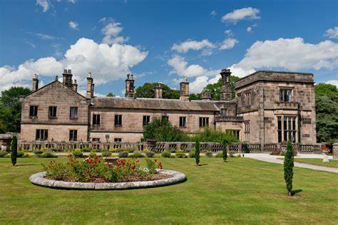
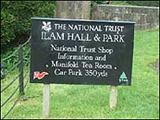
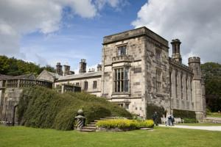
Staffing
The trip will be attended by: Miss Waterall, Mr Nash, Miss Nassau, Miss Stanko, Mrs Richards, Mrs Hornsby, Mrs Baker and Mrs Mayfield.
All activities are run by the Ilam Hall staff who are extremely experienced and vetted.
These activities include orienteering, map reading and science experiments.

Slide 3
Medication
If your child has any medication, for example, inhalers etc, it is essential that they are brought in a sealed, named bag with clear dosage protocols and given directly to the member of staff at the First Aid stand.
Please do not send your child with any medication you have not previously informed the school about e.g. Hay fever tablets or Travel sickness tablets

Slide 4
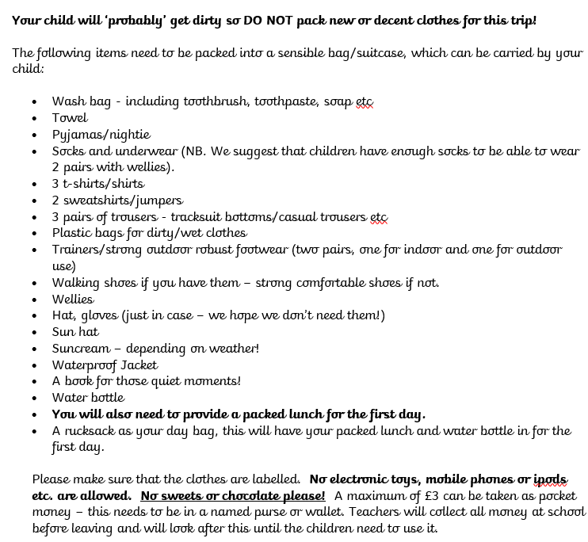
Trip Kit Letter
Your child should bring two bags; A day bag with their lunch in and anything they will need during Wednesday, a bigger bag with the rest of their belongings.
The letter details the kit your child will need for Ilam Hall. Please label all kit.

Slide 5
Trip Kit Letter
When packing please keep in mind that clothes and shoes will be worn to undertake physical outdoor activity, often in muddy conditions, so we strongly recommend packing warm, comfortable clothing and footwear that you’re happy to get wet and muddy!
There will be an opportunity to get an ice cream at Dovedale and so while your child is welcome to bring the recommended pocket money, they should not bring more than £3. Please have this labelled with your child’s name. Teachers will collect all money at school before leaving and will look after this until the children need to use it.

Slide 6
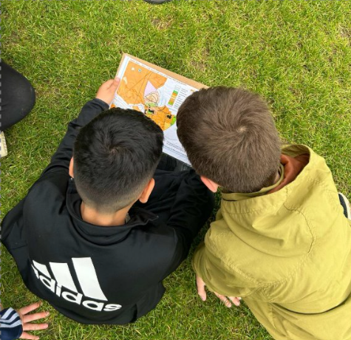
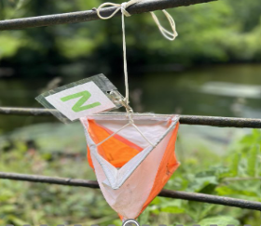
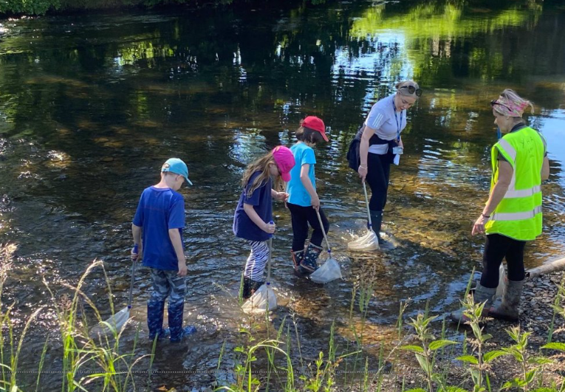
Activities
Compass skills
Orienteering
Team Challenges
Environmental Art
Guided walk to Dovedale
River dipping
Mini Beasts

Slide 7
Wednesday morning
When your child arrives at school at the normal time, they must put their bags in the hall.
Please ensure your child is not late on this day!
Please ensure all bags and belongings are clearly labelled with your child’s name.
We will then leave via coach at approximately 9:30 to arrive at around 12:00.

Slide 8
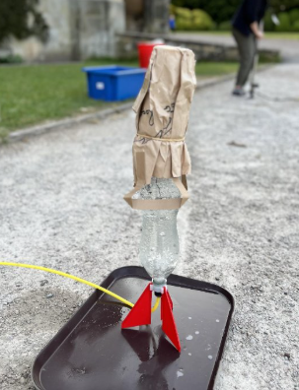
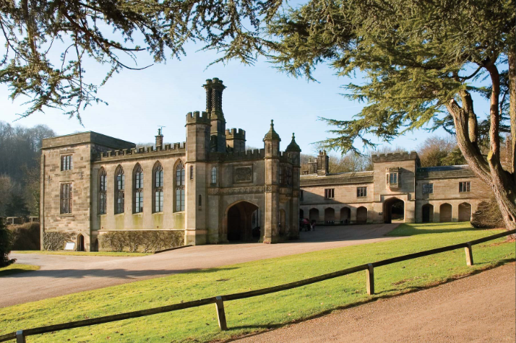
Wednesday
Your child will need to bring a packed lunch in a rucksack with them and will eat this once we arrive at Ilam Hall. They should also have a water bottle and coat with them. They will then meet the centre staff and begin their first afternoon activity.
Activity 1 - 1:30-4:30pm
Evening meal at 5:30pm.
Evening activity: Egg Rockets
Bedtime at 9.00pm

Slide 9
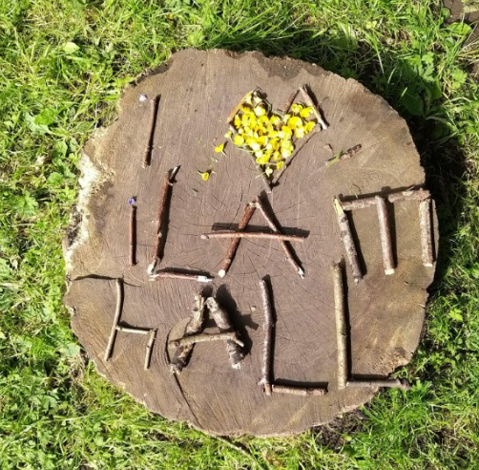
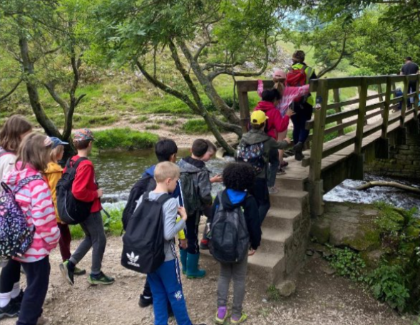
Thursday
Breakfast at 7:30am
Morning Activity at 9:00am
Packed lunch at 12.00 provided by the centre.
Afternoon activity- Team building challenges/ Guided walk to Dovedale
Evening meal at 5:30pm
Evening activity: Bingo night/Film night
Bedtime at 9pm.

Slide 10
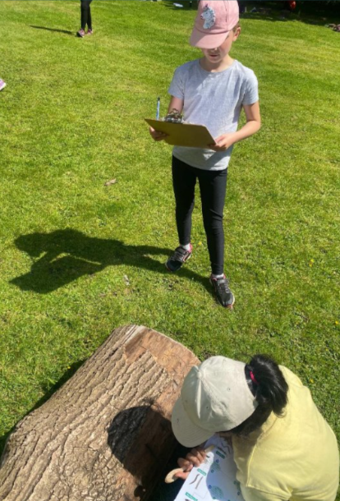
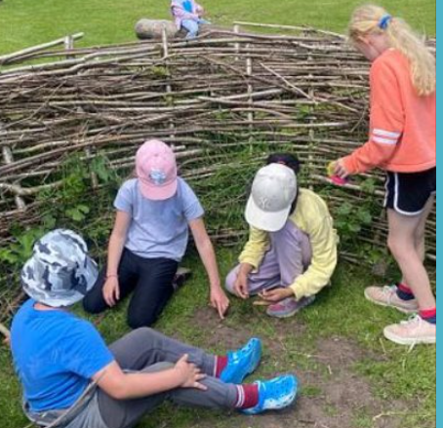
Friday morning
Breakfast at 7:30am
Morning activity at 9:00am
Packed lunch and then departure back to school at 1pm.
If we are delayed, we will contact school who will then send a text out via the school system to inform all Year 4 parents.
You will collect your child (and bags!) at normal time at 3:35pm from the playground.

Slide 11
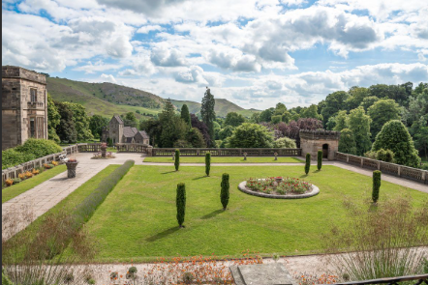
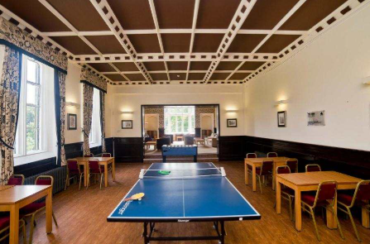
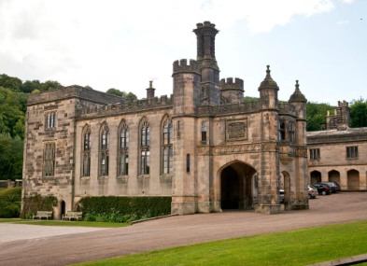
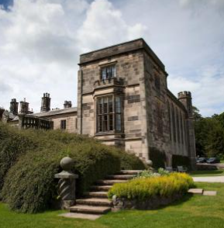
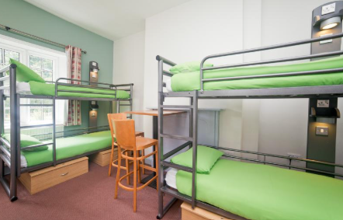
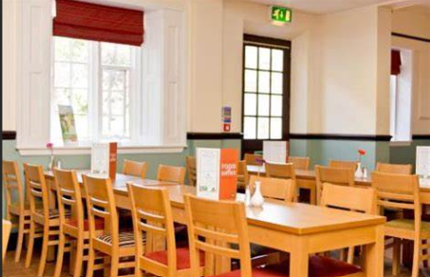
Ilam Hall

Slide 12
Any questions?
Feel free to ask any questions about the trip or any events within the trip.
We know every child will have a super time on their Y4 trip. ☺

